Slide 1
Test-Driven Development Fundamentals on Force.com: Step-by-Step Bowling Kata
Developer Track
Kyle Thornton, Mavens Consulting @knthornt
Sean Harrison, Mavens Consulting @GizmoForce
Notes:
Welcome
session title was changed at last minute
not “Salesforce, the Cloud, **** and You”
Developer track - test-driven development
but before we get into it…

Slide 2
Safe Harbor
Safe harbor statement under the Private Securities Litigation Reform Act of 1995:
This presentation may contain forward-looking statements that involve risks, uncertainties, and assumptions. If any such uncertainties materialize or if any of the assumptions proves incorrect, the results of salesforce.com, inc. could differ materially from the results expressed or implied by the forward-looking statements we make. All statements other than statements of historical fact could be deemed forward-looking, including any projections of product or service availability, subscriber growth, earnings, revenues, or other financial items and any statements regarding strategies or plans of management for future operations, statements of belief, any statements concerning new, planned, or upgraded services or technology developments and customer contracts or use of our services.
The risks and uncertainties referred to above include – but are not limited to – risks associated with developing and delivering new functionality for our service, new products and services, our new business model, our past operating losses, possible fluctuations in our operating results and rate of growth, interruptions or delays in our Web hosting, breach of our security measures, the outcome of intellectual property and other litigation, risks associated with possible mergers and acquisitions, the immature market in which we operate, our relatively limited operating history, our ability to expand, retain, and motivate our employees and manage our growth, new releases of our service and successful customer deployment, our limited history reselling non-salesforce.com products, and utilization and selling to larger enterprise customers. Further information on potential factors that could affect the financial results of salesforce.com, inc. is included in our annual report on Form 10-Q for the most recent fiscal quarter ended July 31, 2012. This documents and others containing important disclosures are available on the SEC Filings section of the Investor Information section of our Web site.
Any unreleased services or features referenced in this or other presentations, press releases or public statements are not currently available and may not be delivered on time or at all. Customers who purchase our services should make the purchase decisions based upon features that are currently available. Salesforce.com, inc. assumes no obligation and does not intend to update these forward-looking statements.
Notes:
if anything we say or do causes Salesforce stock to skyrocket and you forgot to call jump on e*Trade yesterday there’s still time and, besides, I’m sure that, in 20 years, Social Security will be completely solvent. But let’s not think about that, let’s discuss…

Slide 3
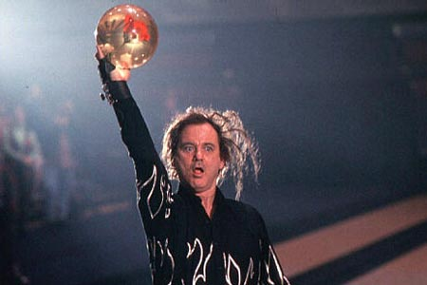
Photo by Metro-Goldwyn-Mayer (MGM) – © 1996 - MGM/UA
Notes:
Bill Murray
Introduce Bowling as the theme
are there any bowlers in the room?
ok, enough of that, let’s talk about unit tests…

Slide 4

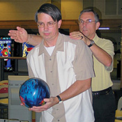
Test-Driven Development
Write your tests before your write your code
Learn by doing
Kata = step-by-step example
Notes:
unit tests coverage – the 75% requirement is your friend
some people start force.com/apex development coding away
get the project
discuss requirements
in the real-world, who has time for writing “tests”?
- they’re not sexy
- the client doesn’t see them
- is there any benefit
So you code away and get it all done and then the unit tests are an afterthought…”oh yeah, I need to cover my code because there’s a 75% requirement”
Is that you?
We’re here to help you, sir (give ‘em bowling shoes)
We are NOT going to change your mind in this session. There’s other real good sessions for that. We will speak to some of the benefits but in this particular session, here at the tail end of the day, [save the best for last!] let’s all agree that you “learn best by doing”
you know what it is
other TDD will try to persuade you
we’re going to show you

Slide 5


Test-Driven Development
Classic Bowling Example
3 of the 5 tests today
4 and 5 online
Provide code for you to finish
Credit where credit is due
2005 version of kata
ObjectMentor.com

Slide 6
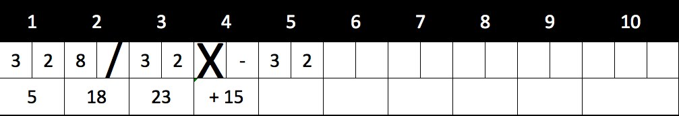
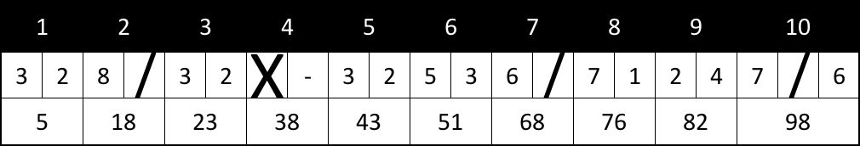
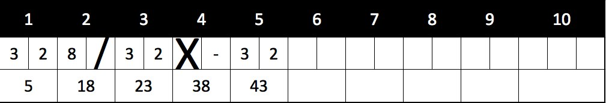
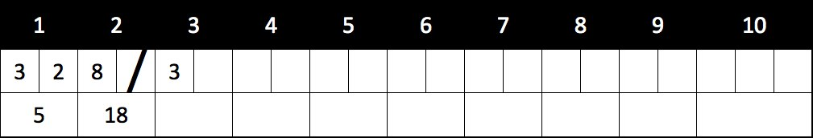
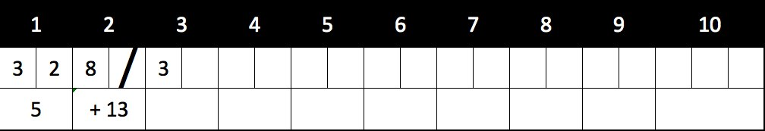
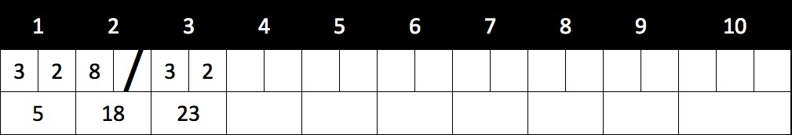
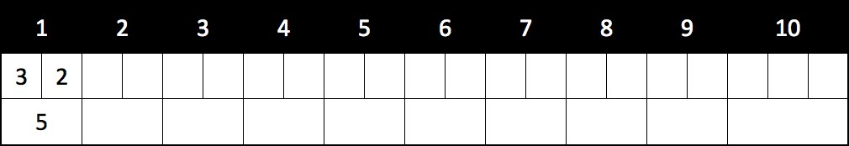
This is not ‘Nam. This is Bowling. There are Rules.
10 Frames / 2 rolls each
Each frame has a score
Frame score = pins down with rolls + bonuses
Bonuses:
Spare = 2 Rolls + 1 bonus roll
Strike = 1 Roll + 2 bonus rolls
10th Frame
rolls as needed
max rolls = 3
Notes:
You’re going to learn how to score a bowling game…

Slide 7
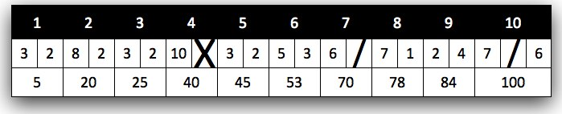
Game
Frame
Roll
roll(Integer)
score()
score()
roll(Integer)
TenthFrame
score()
Notes:
YAGNI !!!!!
What is that? Slavic for…
kyle sez: part of the beauty of TDD is it keeps you from bloating out your design. We might need all this but let’s let the tests drive our needs for this app…

Slide 8
Assumptions
We are only calculating the score
The class we build will be for one bowler
We are not responsible for the input of the scores in this class
There would be a complimentary class to handle the score input

Slide 9
Let’s Define Our Use Cases
Score should be 0 if bowler rolls a complete gutter game
Score should be 20 if bowler knocks down 1 pin every roll
Score calculates properly if bowler rolls a spare
Score calculates properly if bowler rolls a strike
Score is 300 if bowler rolls a perfect game

Slide 10

The First Test
@isTest
private class BowlingGameTest {
static testMethod void testGutterGame() {
Game g = new Game();
}
}

Slide 11
The First Test
@isTest
private class BowlingGameTest {
static testMethod void testGutterGame() {
Game g = new Game();
}
}
public with sharing class Game {
}

Slide 12
The First Test
@isTest
private class BowlingGameTest {
static testMethod void testGutterGame() {
Game g = new Game();
}
}
public with sharing class Game {
}

Slide 13

The First Test
@isTest
private class BowlingGameTest {
static testMethod void testGutterGame() {
Game g = new Game();
}
}
public with sharing class Game {
}

Slide 14
The First Test
@isTest
private class BowlingGameTest {
static testMethod void testGutterGame() {
Game g = new Game();
for (Integer i=0; i<20; i++ ) {
g.roll(0);
}
}
}
public with sharing class Game {
}

Slide 15
The First Test
@isTest
private class BowlingGameTest {
static testMethod void testGutterGame() {
Game g = new Game();
for (Integer i=0; i<20; i++ ) {
g.roll(0);
}
}
}
public with sharing class Game {
public void roll(Integer pins) {
}
}

Slide 16
The First Test
@isTest
private class BowlingGameTest {
static testMethod void testGutterGame() {
Game g = new Game();
for (Integer i=0; i<20; i++ ) {
g.roll(0);
}
System.assertEquals(0,g.score(), ‘Gutter game score not zero');
}
}
public with sharing class Game {
public void roll(Integer pins) {
}
}

Slide 17

The First Test
@isTest
private class BowlingGameTest {
static testMethod void testGutterGame() {
Game g = new Game();
for (Integer i=0; i<20; i++ ) {
g.roll(0);
}
System.assertEquals(0,g.score() ‘Gutter game score not zero');
}
}
public with sharing class Game {
public void roll(Integer pins) {
}
public Integer score() {
return null;
}
}
Expected 0 but returned null

Slide 18
The First Test
@isTest
private class BowlingGameTest {
static testMethod void testGutterGame() {
Game g = new Game();
for (Integer i=0; i<20; i++ ) {
g.roll(0);
}
System.assertEquals(0,g.score(), ‘Gutter game score not zero');
}
}
public with sharing class Game {
public void roll(Integer pins) {
}
public Integer score() {
return 0;
}
}

Slide 19
Unit Test #1 - Score should be 0 if bowler rolls a complete gutter game
Game
public roll(Integer)
public score()
Next Use Case:
Score should be 20 if bowler knocks down 1 pin every roll

Slide 20
The Second Test
@isTest
private class BowlingGameTest {
static testMethod void testGutterGame() {
Game g = new Game();
for (Integer i=0; i<20; i++ ) {
g.roll(0);
}
System.assertEquals(0,g.score(), ‘Gutter game score not zero');
}
static testMethod void testAllOnes() {
Game g = new Game();
for (Integer i=0; i<20; i++ ) {
g.roll(1);
}
System.assertEquals(20,g.score(), 'An all ones game score not 20');
}
}
public with sharing class Game {
public void roll(Integer pins) {
}
public Integer score() {
return 0;
}
}

Slide 21
The Second Test
Game creation is duplicated
Roll loop is duplicated
@isTest
private class BowlingGameTest {
static testMethod void testGutterGame() {
Game g = new Game();
for (Integer i=0; i<20; i++ ) {
g.roll(0);
}
System.assertEquals(0,g.score(), ‘Gutter game score not zero');
}
static testMethod void testAllOnes() {
Game g = new Game();
for (Integer i=0; i<20; i++ ) {
g.roll(1);
}
System.assertEquals(20,g.score(), 'An all ones game score not 20');
}
}
public with sharing class Game {
public void roll(Integer pins) {
}
public Integer score() {
return 0;
}
}

Slide 22
The Second Test
Game creation is duplicated
Roll loop is duplicated
@isTest
private class BowlingGameTest {
static testMethod void testGutterGame() {
Game g = new Game();
for (Integer i=0; i<20; i++ ) {
g.roll(0);
}
System.assertEquals(0,g.score(), ‘Gutter game score not zero');
}
static testMethod void testAllOnes() {
Game g = new Game();
for (Integer i=0; i<20; i++ ) {
g.roll(1);
}
System.assertEquals(20,g.score(), 'An all ones game score not 20');
}
}
public with sharing class Game {
public void roll(Integer pins) {
}
public Integer score() {
return 0;
}
}
Expected 20 but returned 0

Slide 23
The Second Test
Game creation is duplicated
Roll loop is duplicated
@isTest
private class BowlingGameTest {
static testMethod void testGutterGame() {
Game g = new Game();
for (Integer i=0; i<20; i++ ) {
g.roll(0);
}
System.assertEquals(0,g.score(), ‘Gutter game score not zero');
}
static testMethod void testAllOnes() {
Game g = new Game();
for (Integer i=0; i<20; i++ ) {
g.roll(1);
}
System.assertEquals(20,g.score(), 'An all ones game score not 20');
}
}
public with sharing class Game {
private Integer score = 0;
public void roll(Integer pins) {
score += pins;
}
public Integer score() {
return score;
}
}

Slide 24
Let’s Do Some Clean-up
Game creation is duplicated
Roll loop is duplicated
@isTest
private class BowlingGameTest {
static testMethod void testGutterGame() {
Game g = new Game();
for (Integer i=0; i<20; i++ ) {
g.roll(0);
}
System.assertEquals(0,g.score(), ‘Gutter game score not zero');
}
static testMethod void testAllOnes() {
Game g = new Game();
for (Integer i=0; i<20; i++ ) {
g.roll(1);
}
System.assertEquals(20,g.score(), 'An all ones game score not 20');
}
}
public with sharing class Game {
private Integer score = 0;
public void roll(Integer pins) {
score += pins;
}
public Integer score() {
return score;
}
}

Slide 25
Let’s Do Some Clean-up
Game creation is duplicated
Roll loop is duplicated
@isTest
private class BowlingGameTest {
private static Game g = new Game();
static testMethod void testGutterGame() {
for (Integer i=0; i<20; i++ ) {
g.roll(0);
}
System.assertEquals(0,g.score(), ‘Gutter game score not zero');
}
static testMethod void testAllOnes() {
for (Integer i=0; i<20; i++ ) {
g.roll(1);
}
System.assertEquals(20,g.score(), 'An all ones game score not 20');
}
}
public with sharing class Game {
private Integer score = 0;
public void roll(Integer pins) {
score += pins;
}
public Integer score() {
return score;
}
}

Slide 26
Let’s Do Some Clean-up
Roll loop is duplicated
@isTest
private class BowlingGameTest {
private static Game g = new Game();
static testMethod void testGutterGame() {
Integer n = 20;
Integer pins = 0;
for (Integer i=0; i<n; i++ ) {
g.roll(pins);
}
System.assertEquals(0,g.score(), ‘Gutter game score not zero');
}
static testMethod void testAllOnes() {
for (Integer i=0; i<20; i++ ) {
g.roll(1);
}
System.assertEquals(20,g.score(), 'An all ones game score not 20');
}
}
public with sharing class Game {
private Integer score = 0;
public void roll(Integer pins) {
score += pins;
}
public Integer score() {
return score;
}
}

Slide 27
Let’s Do Some Clean-up
Roll loop is duplicated
@isTest
private class BowlingGameTest {
private static Game g = new Game();
private static void rollMany(Integer n, Integer pins) {
for (Integer i=0; i<n; i++) {
g.roll(pins);
}
}
static testMethod void testGutterGame() {
Integer n = 20;
Integer pins = 0;
rollMany(n, pins);
System.assertEquals(0,g.score(), ‘Gutter game score not zero');
}
static testMethod void testAllOnes() {
for (Integer i=0; i<20; i++ ) {
g.roll(1);
}
System.assertEquals(20,g.score(), 'An all ones game score not 20');
}
}
public with sharing class Game {
private Integer score = 0;
public void roll(Integer pins) {
score += pins;
}
public Integer score() {
return score;
}
}

Slide 28
Let’s Do Some Clean-up
Roll loop is duplicated
@isTest
private class BowlingGameTest {
private static Game g = new Game();
private static void rollMany(Integer n, Integer pins) {
for (Integer i=0; i<n; i++) {
g.roll(pins);
}
}
static testMethod void testGutterGame() {
rollMany(20, 0);
System.assertEquals(0,g.score(), ‘Gutter game score not zero');
}
static testMethod void testAllOnes() {
for (Integer i=0; i<20; i++ ) {
g.roll(1);
}
System.assertEquals(20,g.score(), 'An all ones game score not 20');
}
}
public with sharing class Game {
private Integer score = 0;
public void roll(Integer pins) {
score += pins;
}
public Integer score() {
return score;
}
}

Slide 29
Let’s Do Some Clean-up
Roll loop is duplicated
Roll loop is duplicated
@isTest
private class BowlingGameTest {
private static Game g = new Game();
private static void rollMany(Integer n, Integer pins) {
for (Integer i=0; i<n; i++) {
g.roll(pins);
}
}
static testMethod void testGutterGame() {
rollMany(20, 0);
System.assertEquals(0,g.score(), ‘Gutter game score not zero');
}
static testMethod void testAllOnes() {
rollMany(20, 1);
System.assertEquals(20,g.score(), 'An all ones game score not 20');
}
}
public with sharing class Game {
private Integer score = 0;
public void roll(Integer pins) {
score += pins;
}
public Integer score() {
return score;
}
}

Slide 30
Unit Test #2 - Score should be 20 if bowler knocks down 1 pin every roll
Game
Integer score
public roll(Integer)
public score()
Next Use Case:
Score calculates properly if bowler rolls a spare

Slide 31
The Third Test
Ugly comment in test
@isTest
private class BowlingGameTest {
private static Game g = new Game();
private static void rollMany(Integer n, Integer pins) {
for (Integer i=0; i<n; i++) {
g.roll(pins);
}
}
static testMethod void testGutterGame() {
rollMany(20, 0);
System.assertEquals(0,g.score(), ‘Gutter game score not zero');
}
static testMethod void testAllOnes() {
rollMany(20, 1);
System.assertEquals(20,g.score(), 'An all ones game score not 20');
}
static testMethod void testOneSpare() {
g.roll(5);
g.roll(5); //spare
g.roll(3);
rollMany(17,0);
System.assertEquals(16,g.score(), ‘Spare not scored correctly’);
}
}
public with sharing class Game {
private Integer score = 0;
public void roll(Integer pins) {
score += pins;
}
public Integer score() {
return score;
}
}
Ugly comment

Slide 32
The Third Test
Ugly comment in test
@isTest
private class BowlingGameTest {
private static Game g = new Game();
private static void rollMany(Integer n, Integer pins) {
for (Integer i=0; i<n; i++) {
g.roll(pins);
}
}
static testMethod void testGutterGame() {
rollMany(20, 0);
System.assertEquals(0,g.score(), ‘Gutter game score not zero');
}
static testMethod void testAllOnes() {
rollMany(20, 1);
System.assertEquals(20,g.score(), 'An all ones game score not 20');
}
static testMethod void testOneSpare() {
g.roll(5);
g.roll(5); //spare
g.roll(3);
rollMany(17,0);
System.assertEquals(16,g.score(), ‘Spare not scored correctly’);
}
}
public with sharing class Game {
private Integer score = 0;
public void roll(Integer pins) {
score += pins;
}
public Integer score() {
return score;
}
}
Expected 16 but returned 13

Slide 33
The Third Test
Ugly comment in test
@isTest
private class BowlingGameTest {
private static Game g = new Game();
private static void rollMany(Integer n, Integer pins) {
for (Integer i=0; i<n; i++) {
g.roll(pins);
}
}
static testMethod void testGutterGame() {
rollMany(20, 0);
System.assertEquals(0,g.score(), ‘Gutter game score not zero');
}
static testMethod void testAllOnes() {
rollMany(20, 1);
System.assertEquals(20,g.score(), 'An all ones game score not 20');
}
static testMethod void testOneSpare() {
g.roll(5);
g.roll(5); //spare
g.roll(3);
rollMany(17,0);
System.assertEquals(16,g.score(), ‘Spare not scored correctly’);
}
}
public with sharing class Game {
private Integer score = 0;
public void roll(Integer pins) {
score += pins;
}
public Integer score() {
return score;
}
}
Tempted to use flag to
Remember previous roll.
Design must be wrong.
Roll() calculates score
score() does not calculate score, but name implies that it does.
Design is not going in the right direction.
-Methods doing the wrong job
-Going down a design path we would rather avoid
Let’s comment out testOneSpare and do some rework

Slide 34
The Third Test
Ugly comment in test
@isTest
private class BowlingGameTest {
private static Game g = new Game();
private static void rollMany(Integer n, Integer pins) {
for (Integer i=0; i<n; i++) {
g.roll(pins);
}
}
static testMethod void testGutterGame() {
rollMany(20, 0);
System.assertEquals(0,g.score(), ‘Gutter game score not zero');
}
static testMethod void testAllOnes() {
rollMany(20, 1);
System.assertEquals(20,g.score(), 'An all ones game score not 20');
}
// static testMethod void testOneSpare() {
// g.roll(5);
// g.roll(5); //spare
// g.roll(3);
// rollMany(17,0);
// System.assertEquals(16,g.score(), ‘Spare not scored correctly’);
//}
}
public with sharing class Game {
private Integer score = 0;
public void roll(Integer pins) {
score += pins;
}
public Integer score() {
return score;
}
}

Slide 35
The Third Test
Ugly comment in test
@isTest
private class BowlingGameTest {
private static Game g = new Game();
private static void rollMany(Integer n, Integer pins) {
for (Integer i=0; i<n; i++) {
g.roll(pins);
}
}
static testMethod void testGutterGame() {
rollMany(20, 0);
System.assertEquals(0,g.score(), ‘Gutter game score not zero');
}
static testMethod void testAllOnes() {
rollMany(20, 1);
System.assertEquals(20,g.score(), 'An all ones game score not 20');
}
// static testMethod void testOneSpare() {
// g.roll(5);
// g.roll(5); //spare
// g.roll(3);
// rollMany(17,0);
// System.assertEquals(16,g.score(), ‘Spare not scored correctly’);
//}
}
public with sharing class Game {
private Integer score = 0;
private list<Integer> rolls =
new list<Integer>{0,0,0,0,0,0,0,0,0,0,0,0,0,0,0,0,0,0,0,0,0};
private Integer currentRoll = 0;
public void roll(Integer pins) {
score += pins;
rolls[curentRoll++] = pins;
}
public Integer score() {
return score;
}
}

Slide 36
The Third Test
Ugly comment in test
@isTest
private class BowlingGameTest {
private static Game g = new Game();
private static void rollMany(Integer n, Integer pins) {
for (Integer i=0; i<n; i++) {
g.roll(pins);
}
}
static testMethod void testGutterGame() {
rollMany(20, 0);
System.assertEquals(0,g.score(), ‘Gutter game score not zero');
}
static testMethod void testAllOnes() {
rollMany(20, 1);
System.assertEquals(20,g.score(), 'An all ones game score not 20');
}
// static testMethod void testOneSpare() {
// g.roll(5);
// g.roll(5); //spare
// g.roll(3);
// rollMany(17,0);
// System.assertEquals(16,g.score(), ‘Spare not scored correctly’);
//}
}
public with sharing class Game {
private Integer score = 0;
private list<Integer> rolls =
new list<Integer>{0,0,0,0,0,0,0,0,0,0,0,0,0,0,0,0,0,0,0,0,0};
private Integer currentRoll = 0;
public void roll(Integer pins) {
score += pins;
rolls[curentRoll++] = pins;
}
public Integer score() {
Integer score = 0;
for (Integer i=0, i<rolls.length; i++) {
score += rolls[i];
}
return score;
}
}

Slide 37
The Third Test
Ugly comment in test
@isTest
private class BowlingGameTest {
private static Game g = new Game();
private static void rollMany(Integer n, Integer pins) {
for (Integer i=0; i<n; i++) {
g.roll(pins);
}
}
static testMethod void testGutterGame() {
rollMany(20, 0);
System.assertEquals(0,g.score(), ‘Gutter game score not zero');
}
static testMethod void testAllOnes() {
rollMany(20, 1);
System.assertEquals(20,g.score(), 'An all ones game score not 20');
}
// static testMethod void testOneSpare() {
// g.roll(5);
// g.roll(5); //spare
// g.roll(3);
// rollMany(17,0);
// System.assertEquals(16,g.score(), ‘Spare not scored correctly’);
//}
}
public with sharing class Game {
private list<Integer> rolls =
new list<Integer>{0,0,0,0,0,0,0,0,0,0,0,0,0,0,0,0,0,0,0,0,0};
private Integer currentRoll = 0;
public void roll(Integer pins) {
rolls[curentRoll++] = pins;
}
public Integer score() {
Integer score = 0;
for (Integer i=0, i<rolls.length; i++) {
score += rolls[i];
}
return score;
}
}

Slide 38
The Third Test
Ugly comment in test
@isTest
private class BowlingGameTest {
private static Game g = new Game();
private static void rollMany(Integer n, Integer pins) {
for (Integer i=0; i<n; i++) {
g.roll(pins);
}
}
static testMethod void testGutterGame() {
rollMany(20, 0);
System.assertEquals(0,g.score(), ‘Gutter game score not zero');
}
static testMethod void testAllOnes() {
rollMany(20, 1);
System.assertEquals(20,g.score(), 'An all ones game score not 20');
}
static testMethod void testOneSpare() {
g.roll(5);
g.roll(5); //spare
g.roll(3);
rollMany(17,0);
System.assertEquals(16,g.score(), ‘Spare not scored correctly’);
}
}
public with sharing class Game {
private list<Integer> rolls =
new list<Integer>{0,0,0,0,0,0,0,0,0,0,0,0,0,0,0,0,0,0,0,0,0};
private Integer currentRoll = 0;
public void roll(Integer pins) {
rolls[curentRoll++] = pins;
}
public Integer score() {
Integer score = 0;
for (Integer i=0, i<rolls.length; i++) {
score += rolls[i];
}
return score;
}
}
Expected 16 but returned 13

Slide 39
The Third Test
Ugly comment in test
@isTest
private class BowlingGameTest {
private static Game g = new Game();
private static void rollMany(Integer n, Integer pins) {
for (Integer i=0; i<n; i++) {
g.roll(pins);
}
}
static testMethod void testGutterGame() {
rollMany(20, 0);
System.assertEquals(0,g.score(), ‘Gutter game score not zero');
}
static testMethod void testAllOnes() {
rollMany(20, 1);
System.assertEquals(20,g.score(), 'An all ones game score not 20');
}
static testMethod void testOneSpare() {
g.roll(5);
g.roll(5); //spare
g.roll(3);
rollMany(17,0);
System.assertEquals(16,g.score(), ‘Spare not scored correctly’);
}
}
public with sharing class Game {
private list<Integer> rolls =
new list<Integer>{0,0,0,0,0,0,0,0,0,0,0,0,0,0,0,0,0,0,0,0,0};
private Integer currentRoll = 0;
public void roll(Integer pins) {
rolls[curentRoll++] = pins;
}
public Integer score() {
Integer score = 0;
for (Integer i=0, i<rolls.length; i++) {
if (rolls[i] + rolls[i+1] == 10) { //spare
score+=…..
}
score += rolls[i];
}
return score;
}
}
This isn’t going to work because I might not refer to the first ball of the frame.
Design is still wrong.
Need to walk through array one frame (two balls) at a time.

Slide 40
The Third Test
Ugly comment in test
@isTest
private class BowlingGameTest {
private static Game g = new Game();
private static void rollMany(Integer n, Integer pins) {
for (Integer i=0; i<n; i++) {
g.roll(pins);
}
}
static testMethod void testGutterGame() {
rollMany(20, 0);
System.assertEquals(0,g.score(), ‘Gutter game score not zero');
}
static testMethod void testAllOnes() {
rollMany(20, 1);
System.assertEquals(20,g.score(), 'An all ones game score not 20');
}
// static testMethod void testOneSpare() {
// g.roll(5);
// g.roll(5); //spare
// g.roll(3);
// rollMany(17,0);
// System.assertEquals(16,g.score(), ‘Spare not scored correctly’);
//}
}
public with sharing class Game {
private list<Integer> rolls =
new list<Integer>{0,0,0,0,0,0,0,0,0,0,0,0,0,0,0,0,0,0,0,0,0};
private Integer currentRoll = 0;
public void roll(Integer pins) {
rolls[curentRoll++] = pins;
}
public Integer score() {
Integer score = 0;
Integer i = 0;
for (Integer frame=0, frame<10; frame++) {
score += rolls[i] + rolls[i+1];
i+=2;
}
return score;
}
}

Slide 41
The Third Test
Ugly comment in test
@isTest
private class BowlingGameTest {
private static Game g = new Game();
private static void rollMany(Integer n, Integer pins) {
for (Integer i=0; i<n; i++) {
g.roll(pins);
}
}
static testMethod void testGutterGame() {
rollMany(20, 0);
System.assertEquals(0,g.score(), ‘Gutter game score not zero');
}
static testMethod void testAllOnes() {
rollMany(20, 1);
System.assertEquals(20,g.score(), 'An all ones game score not 20');
}
static testMethod void testOneSpare() {
g.roll(5);
g.roll(5); //spare
g.roll(3);
rollMany(17,0);
System.assertEquals(16,g.score(), ‘Spare not scored correctly’);
}
}
public with sharing class Game {
private list<Integer> rolls =
new list<Integer>{0,0,0,0,0,0,0,0,0,0,0,0,0,0,0,0,0,0,0,0,0};
private Integer currentRoll = 0;
public void roll(Integer pins) {
rolls[curentRoll++] = pins;
}
public Integer score() {
Integer score = 0;
Integer i = 0;
for (Integer frame=0, frame<10; frame++) {
score += rolls[i] + rolls[i+1];
i+=2;
}
return score;
}
}
Expected 16 but returned 13

Slide 42
The Third Test
Ugly comment in test
@isTest
private class BowlingGameTest {
private static Game g = new Game();
private static void rollMany(Integer n, Integer pins) {
for (Integer i=0; i<n; i++) {
g.roll(pins);
}
}
static testMethod void testGutterGame() {
rollMany(20, 0);
System.assertEquals(0,g.score(), ‘Gutter game score not zero');
}
static testMethod void testAllOnes() {
rollMany(20, 1);
System.assertEquals(20,g.score(), 'An all ones game score not 20');
}
static testMethod void testOneSpare() {
g.roll(5);
g.roll(5); //spare
g.roll(3);
rollMany(17,0);
System.assertEquals(16,g.score(), ‘Spare not scored correctly’);
}
}
public with sharing class Game {
private list<Integer> rolls =
new list<Integer>{0,0,0,0,0,0,0,0,0,0,0,0,0,0,0,0,0,0,0,0,0};
private Integer currentRoll = 0;
public void roll(Integer pins) {
rolls[curentRoll++] = pins;
}
public Integer score() {
Integer score = 0;
Integer i = 0;
for (Integer frame=0, frame<10; frame++) {
if (rolls[i] + rolls[i+1] == 10) { //spare
score += 10 + rolls[i+2];
i += 2;
} else {
score += rolls[i] + rolls[i+1];
i+=2;
}
}
return score;
}
}

Slide 43
Some More Clean-up
Ugly comment in test
Ugly comment in conditional
i is a bad variable name
@isTest
private class BowlingGameTest {
private static Game g = new Game();
private static void rollMany(Integer n, Integer pins) {
for (Integer i=0; i<n; i++) {
g.roll(pins);
}
}
static testMethod void testGutterGame() {
rollMany(20, 0);
System.assertEquals(0,g.score(), ‘Gutter game score not zero');
}
static testMethod void testAllOnes() {
rollMany(20, 1);
System.assertEquals(20,g.score(), 'An all ones game score not 20');
}
static testMethod void testOneSpare() {
g.roll(5);
g.roll(5); //spare
g.roll(3);
rollMany(17,0);
System.assertEquals(16,g.score(), ‘Spare not scored correctly’);
}
}
public with sharing class Game {
private list<Integer> rolls =
new list<Integer>{0,0,0,0,0,0,0,0,0,0,0,0,0,0,0,0,0,0,0,0,0};
private Integer currentRoll = 0;
public void roll(Integer pins) {
rolls[curentRoll++] = pins;
}
public Integer score() {
Integer score = 0;
Integer i = 0;
for (Integer frame=0, frame<10; frame++) {
if (rolls[i] + rolls[i+1] == 10) { //spare
score += 10 + rolls[i+2];
i += 2;
} else {
score += rolls[i] + rolls[i+1];
i+=2;
}
}
return score;
}
}
Bad variable name
Ugly Comment

Slide 44
Some More Clean-up
Ugly comment in test
Ugly comment in conditional
@isTest
private class BowlingGameTest {
private static Game g = new Game();
private static void rollMany(Integer n, Integer pins) {
for (Integer i=0; i<n; i++) {
g.roll(pins);
}
}
static testMethod void testGutterGame() {
rollMany(20, 0);
System.assertEquals(0,g.score(), ‘Gutter game score not zero');
}
static testMethod void testAllOnes() {
rollMany(20, 1);
System.assertEquals(20,g.score(), 'An all ones game score not 20');
}
static testMethod void testOneSpare() {
g.roll(5);
g.roll(5); //spare
g.roll(3);
rollMany(17,0);
System.assertEquals(16,g.score(), ‘Spare not scored correctly’);
}
}
public with sharing class Game {
private list<Integer> rolls =
new list<Integer>{0,0,0,0,0,0,0,0,0,0,0,0,0,0,0,0,0,0,0,0,0};
private Integer currentRoll = 0;
public void roll(Integer pins) {
rolls[curentRoll++] = pins;
}
public Integer score() {
Integer score = 0;
Integer rollsIndex = 0;
for (Integer frame=0, frame<10; frame++) {
if ( rolls[rollsIndex] + rolls[rollsIndex+1]) { //spare
score += 10 + rolls[i+2];
rollsIndex += 2;
} else {
score += rolls[rollsIndex] + rolls[rollsIndex+1];
rollsIndex+=2;
}
}
return score;
}
}

Slide 45
Some More Clean-up
Ugly comment in test
@isTest
private class BowlingGameTest {
private static Game g = new Game();
private static void rollMany(Integer n, Integer pins) {
for (Integer i=0; i<n; i++) {
g.roll(pins);
}
}
static testMethod void testGutterGame() {
rollMany(20, 0);
System.assertEquals(0,g.score(), ‘Gutter game score not zero');
}
static testMethod void testAllOnes() {
rollMany(20, 1);
System.assertEquals(20,g.score(), 'An all ones game score not 20');
}
static testMethod void testOneSpare() {
g.roll(5);
g.roll(5); //spare
g.roll(3);
rollMany(17,0);
System.assertEquals(16,g.score(), ‘Spare not scored correctly’);
}
}
public with sharing class Game {
private list<Integer> rolls =
new list<Integer>{0,0,0,0,0,0,0,0,0,0,0,0,0,0,0,0,0,0,0,0,0};
private Integer currentRoll = 0;
public void roll(Integer pins) {
rolls[curentRoll++] = pins;
}
public Integer score() {
Integer score = 0;
Integer rollsIndex = 0;
for (Integer frame=0, frame<10; frame++) {
if ( isSpare(rollsIndex)) {
score += 10 + rolls[i+2];
rollsIndex += 2;
} else {
score += rolls[rollsIndex] + rolls[rollsIndex+1];
rollsIndex+=2;
}
}
return score;
}
private Boolean isSpare(Integer rollsIndex) {
return rolls[rollsIndex] + rolls[rollsIndex+1] == 10;
}
}

Slide 46
Some More Clean-up
@isTest
private class BowlingGameTest {
private static Game g = new Game();
……..
static testMethod void testGutterGame() {
rollMany(20, 0);
System.assertEquals(0,g.score(), ‘Gutter game score not zero');
}
static testMethod void testAllOnes() {
rollMany(20, 1);
System.assertEquals(20,g.score(), 'An all ones game score not 20');
}
static testMethod void testOneSpare() {
rollSpare();
g.roll(3);
rollMany(17,0);
System.assertEquals(16,g.score(), ‘Spare not scored correctly’);
}
private static void rollSpare() {
g.roll(5);
g.roll(5);
}
}
public with sharing class Game {
private list<Integer> rolls =
new list<Integer>{0,0,0,0,0,0,0,0,0,0,0,0,0,0,0,0,0,0,0,0,0};
private Integer currentRoll = 0;
public void roll(Integer pins) {
rolls[curentRoll++] = pins;
}
public Integer score() {
Integer score = 0;
Integer rollsIndex = 0;
for (Integer frame=0, frame<10; frame++) {
if ( isSpare(rollsIndex)) {
score += 10 + rolls[i+2];
rollsIndex += 2;
} else {
score += rolls[rollsIndex] + rolls[rollsIndex+1];
rollsIndex+=2;
}
}
return score;
}
private Boolean isSpare(Integer rollsIndex) {
return rolls[rollsIndex] + rolls[rollsIndex+1] == 10;
}
}

Slide 47
Unit Test #3 – Score calculates properly if bowler rolls a spare
Game
List rolls
Integer currentRoll
public roll(Integer)
public score()
isSpare(Integer)
Next Use Case:
Score calculates properly if bowler rolls a strike

Slide 48
The Fourth Test
Ugly comment in test
@isTest
private class BowlingGameTest {
private static Game g = new Game();
……..
static testMethod void testAllOnes() {
rollMany(20, 1);
System.assertEquals(20,g.score(), 'An all ones game score not 20');
}
static testMethod void testOneSpare() {
rollSpare();
g.roll(3);
rollMany(17,0);
System.assertEquals(16,g.score(), ‘Spare not scored correctly’);
}
public testMethod void testOneStrike() {
g.roll(10); //strike
g.roll(3);
g.roll(4);
rollMany(16, 0);
System.assertEquals(24, g.score(), ‘One strike not scored correctly);
}
private static void rollSpare() {
g.roll(5);
g.roll(5);
}
}
public with sharing class Game {
private list<Integer> rolls =
new list<Integer>{0,0,0,0,0,0,0,0,0,0,0,0,0,0,0,0,0,0,0,0,0};
private Integer currentRoll = 0;
public void roll(Integer pins) {
rolls[curentRoll++] = pins;
}
public Integer score() {
Integer score = 0;
Integer rollsIndex = 0;
for (Integer frame=0, frame<10; frame++) {
if ( isSpare(rollsIndex)) {
score += 10 + rolls[i+2];
rollsIndex += 2;
} else {
score += rolls[rollsIndex] + rolls[rollsIndex+1];
rollsIndex+=2;
}
}
return score;
}
private Boolean isSpare(Integer rollsIndex) {
return rolls[rollsIndex] + rolls[rollsIndex+1] == 10;
}
}
Ugly Comment

Slide 49
The Fourth Test
Ugly comment in test
Ugly comment in conditional
Ugly expressions
@isTest
private class BowlingGameTest {
private static Game g = new Game();
……..
static testMethod void testAllOnes() {
rollMany(20, 1);
System.assertEquals(20,g.score(), 'An all ones game score not 20');
}
static testMethod void testOneSpare() {
rollSpare();
g.roll(3);
rollMany(17,0);
System.assertEquals(16,g.score(), ‘Spare not scored correctly’);
}
public testMethod void testOneStrike() {
g.roll(10); //strike
g.roll(3);
g.roll(4);
rollMany(16, 0);
System.assertEquals(24, g.score(), ‘One strike not scored correctly);
}
private static void rollSpare() {
g.roll(5);
g.roll(5);
}
}
public with sharing class Game {
private list<Integer> rolls =
new list<Integer>{0,0,0,0,0,0,0,0,0,0,0,0,0,0,0,0,0,0,0,0,0};
private Integer currentRoll = 0;
………
public Integer score() {
Integer score = 0;
Integer rollsIndex = 0;
for (Integer frame=0, frame<10; frame++) {
if (rolls[rollsIndex] == 10) { //strike
score += 10 + rolls[rollsIndex+1] + rolls[rollsIndex+2];
rollsIndex++;
} else if ( isSpare(rollsIndex)) {
score += 10 + rolls[i+2];
rollsIndex += 2;
} else {
score += rolls[rollsIndex] + rolls[rollsIndex+1];
rollsIndex+=2;
}
}
return score;
}
private Boolean isSpare(Integer rollsIndex) {
return rolls[rollsIndex] + rolls[rollsIndex+1] == 10;
}
}
Ugly Comment
Ugly Expression
Ugly Expressions
Ugly Expression

Slide 50
The Fourth Test
Ugly comment in test
Ugly comment in conditional
Ugly expressions
@isTest
private class BowlingGameTest {
private static Game g = new Game();
……..
static testMethod void testAllOnes() {
rollMany(20, 1);
System.assertEquals(20,g.score(), 'An all ones game score not 20');
}
static testMethod void testOneSpare() {
rollSpare();
g.roll(3);
rollMany(17,0);
System.assertEquals(16,g.score(), ‘Spare not scored correctly’);
}
public testMethod void testOneStrike() {
g.roll(10); //strike
g.roll(3);
g.roll(4);
rollMany(16, 0);
System.assertEquals(24, g.score(), ‘One strike not scored correctly);
}
private static void rollSpare() {
g.roll(5);
g.roll(5);
}
}
public with sharing class Game {
private list<Integer> rolls =
new list<Integer>{0,0,0,0,0,0,0,0,0,0,0,0,0,0,0,0,0,0,0,0,0};
private Integer currentRoll = 0;
………
public Integer score() {
Integer score = 0;
Integer rollsIndex = 0;
for (Integer frame=0, frame<10; frame++) {
if (rolls[rollsIndex] == 10) { //strike
score += 10 + rolls[rollsIndex+1] + rolls[rollsIndex+2];
rollsIndex++;
} else if ( isSpare(rollsIndex)) {
score += 10 + rolls[i+2];
rollsIndex += 2;
} else {
score += rolls[rollsIndex] + rolls[rollsIndex+1];
rollsIndex+=2;
}
}
return score;
}
private Boolean isSpare(Integer rollsIndex) {
return rolls[rollsIndex] + rolls[rollsIndex+1] == 10;
}
}

Slide 51
The Fourth Test
Ugly comment in test
Ugly comment in conditional
public with sharing class Game {
……..
public Integer score() {
Integer score = 0;
Integer rollsIndex = 0;
for (Integer frame=0, frame<10; frame++) {
if (rolls[rollsIndex] == 10) { //strike
score += 10 + strikeBonus(rollsIndex);
rollsIndex++;
} else if ( isSpare(rollsIndex)) {
score += 10 + spareBonus(rollsIndex);
rollsIndex += 2;
} else {
score += sumOfBallsInFrame(rollsIndex);
rollsIndex+=2;
}
}
return score;
}
private Integer sumOfBallsInFrame(Integer rollsIndex) {
return rolls[rollsIndex] + rolls[rollsIndex+1];
}
private Integer spareBounus(Integer rollsIndex) {
return rolls[rollsIndex+2];
}
private Integer strikeBounus(Integer rollsIndex) {
return rolls[rollsIndex+1] + rolls[rollsIndex+2];
}
private Boolean isSpare(Integer rollsIndex) {
return rolls[rollsIndex] + rolls[rollsIndex] == 10;
}
}
@isTest
private class BowlingGameTest {
private static Game g = new Game();
……..
static testMethod void testAllOnes() {
rollMany(20, 1);
System.assertEquals(20,g.score(), 'An all ones game score not 20');
}
static testMethod void testOneSpare() {
rollSpare();
g.roll(3);
rollMany(17,0);
System.assertEquals(16,g.score(), ‘Spare not scored correctly’);
}
public testMethod void testOneStrike() {
g.roll(10); //strike
g.roll(3);
g.roll(4);
rollMany(16, 0);
System.assertEquals(24, g.score(), ‘One strike not scored correctly);
}
private static void rollSpare() {
g.roll(5);
g.roll(5);
}
}

Slide 52
The Fourth Test
public with sharing class Game {
……..
public Integer score() {
Integer score = 0;
Integer rollsIndex = 0;
for (Integer frame=0, frame<10; frame++) {
if (isStrike(rollsIndex)) {
score += 10 + strikeBonus(rollsIndex);
rollsIndex++;
} else if ( isSpare(rollsIndex)) {
score += 10 + spareBonus(rollsIndex);
rollsIndex += 2;
} else {
score += sumOfBallsInFrame(rollsIndex);
rollsIndex+=2;
}
}
return score;
}
private Boolean isStrike(Integer rollsIndex) {
return rolls[rollsIndex] == 10;
}
private Integer sumOfBallsInFrame(Integer rollsIndex) {
return rolls[rollsIndex] + rolls[rollsIndex+1];
}
private Integer spareBounus(Integer rollsIndex) {
return rolls[rollsIndex+2];
}
private Integer strikeBounus(Integer rollsIndex) {
return rolls[rollsIndex+1] + rolls[rollsIndex+2];
}
private Boolean isSpare(Integer rollsIndex) {
return rolls[rollsIndex] + rolls[rollsIndex+1] == 10;
}
}
Ugly comment in test
@isTest
private class BowlingGameTest {
private static Game g = new Game();
……..
static testMethod void testAllOnes() {
rollMany(20, 1);
System.assertEquals(20,g.score(), 'An all ones game score not 20');
}
static testMethod void testOneSpare() {
rollSpare();
g.roll(3);
rollMany(17,0);
System.assertEquals(16,g.score(), ‘Spare not scored correctly’);
}
public testMethod void testOneStrike() {
g.roll(10); //strike
g.roll(3);
g.roll(4);
rollMany(16, 0);
System.assertEquals(24, g.score(), ‘One strike not scored correctly);
}
private static void rollSpare() {
g.roll(5);
g.roll(5);
}
}

Slide 53
The Fourth Test
public with sharing class Game {
private list<Integer> rolls =
new list<Integer>{0,0,0,0,0,0,0,0,0,0,0,0,0,0,0,0,0,0,0,0,0};
private Integer currentRoll = 0;
public void roll(Integer pins) {
rolls[curentRoll++] = pins;
}
public Integer score() {
Integer score = 0;
Integer rollsIndex = 0;
for (Integer frame=0, frame<10; frame++) {
if (isStrike(rollsIndex)) {
score += 10 + strikeBonus(rollsIndex);
rollsIndex++;
} else if ( isSpare(rollsIndex)) {
score += 10 + spareBonus(rollsIndex);
rollsIndex += 2;
} else {
score += sumOfBallsInFrame(rollsIndex);
rollsIndex+=2;
}
}
return score;
}
private Boolean isStrike(Integer rollsIndex) {
return rolls[rollsIndex] == 10;
}
private Integer sumOfBallsInFrame(Integer rollsIndex) {
return rolls[rollsIndex] + rolls[rollsIndex+1];
}
private Integer spareBounus(Integer rollsIndex) {
return rolls[rollsIndex+2];
}
private Integer strikeBounus(Integer rollsIndex) {
return rolls[rollsIndex+1] + rolls[rollsIndex+2];
}
private Boolean isSpare(Integer rollsIndex) {
return rolls[rollsIndex] + rolls[rollsIndex+1] == 10;
}
}
@isTest
private class BowlingGameTest {
private static Game g = new Game();
……..
static testMethod void testOneSpare() {
rollSpare();
g.roll(3);
rollMany(17,0);
System.assertEquals(16,g.score(), ‘Spare not scored correctly’);
}
public testMethod void testOneStrike() {
rollStrike(10);
g.roll(3);
g.roll(4);
rollMany(16, 0);
System.assertEquals(24, g.score(), ‘One strike not scored correctly);
}
private static void rollSpare() {
g.roll(5);
g.roll(5);
}
private static void rollStrike() {
g.roll(10);
}
}

Slide 54
Unit Test #4 – Score calculates properly if bowler rolls a strike
Game
List rolls
Integer currentRoll
public roll(Integer)
public score()
isSpare(Integer)
isStrike(Integer)
sumOfBallsInFrame(Integer)
spareBonus(Integer)
strikeBonus(Integer)
Next Use Case:
Score is 300 if bowler rolls a perfect game

Slide 55
The Fifth Test
public with sharing class Game {
……..
public Integer score() {
Integer score = 0;
Integer rollsIndex = 0;
for (Integer frame=0, frame<10; frame++) {
if (isStrike(rollsIndex)) {
score += 10 + strikeBonus(rollsIndex);
rollsIndex++;
} else if ( isSpare(rollsIndex)) {
score += 10 + spareBonus(rollsIndex);
rollsIndex += 2;
} else {
score += sumOfBallsInFrame(rollsIndex);
rollsIndex+=2;
}
}
return score;
}
private Boolean isStrike(Integer rollsIndex) {
return rolls[rollsIndex] == 10;
}
private Integer sumOfBallsInFrame(Integer rollsIndex) {
return rolls[rollsIndex] + rolls[rollsIndex+1];
}
private Integer spareBounus(Integer rollsIndex) {
return rolls[rollsIndex+2];
}
private Integer strikeBounus(Integer rollsIndex) {
return rolls[rollsIndex+1] + rolls[rollsIndex+2];
}
private Boolean isSpare(Integer rollsIndex) {
return rolls[rollsIndex] + rolls[rollsIndex+1] == 10;
}
}
……..
static testMethod void testOneSpare() {
rollSpare();
g.roll(3);
rollMany(17,0);
System.assertEquals(16,g.score(), ‘Spare not scored correctly’);
}
public testMethod void testOneStrike() {
rollStrike(10);
g.roll(3);
g.roll(4);
rollMany(16, 0);
System.assertEquals(24, g.score(), ‘One strike not scored correctly);
}
private testMethod void testPerfectGame() {
rollMany(12,10);
System.assertEquals(300, g.score(), ‘Perfect Game not scored correctly);
}
private static void rollSpare() {
g.roll(5);
g.roll(5);
}
private static void rollStrike() {
g.roll(10);
}
}

Slide 56
Unit Test #5 – Score is 300 if bowler rolls a perfect game
Game
List rolls
Integer currentRoll
public roll(Integer)
public score()
isSpare(Integer)
isStrike(Integer)
sumOfBallsInFrame(Integer)
spareBonus(Integer)
strikeBonus(Integer)

Slide 57
What Have We Seen?
A disciplined test-driven approach means…
…Clean, more readable code
…Refining our design as we go
…Quicker feedback
…Regression testing becomes trivial
Notes:
Other benefits:
Test-driven saves LOADS of time when doing QA
Saves MEGA LOADS when doing regression testing

Slide 58
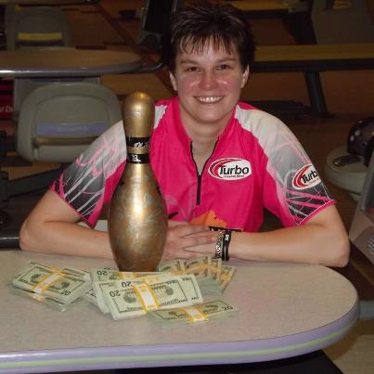
Follow-up
You finish the app with the following:
https://github.com/knthornt/Dreamforce-2012---TDD-Session
Complete Slide Deck (with tests 4 & 5)
Tests 1 – 3 package
Fully baked version
Completed kata video
http://bit.ly/U9dKa8

Slide 59

Thank You!
Kyle Thornton, Mavens Consulting @knthornt
Sean Harrison, Mavens Consulting @GizmoForce
Mavens
MavensConsulting.com info@mavens.io 312.725.8528
Notes:
Q & A - time to discuss before getting beer or anit-oxidant rich green tea, as your preferences dictate
Other benefits:
Test-driven saves LOADS of time when doing QA
Saves MEGA LOADS when doing regression testing

